Slide 1
A STAR
version 1.1
Dr Armin Chitizadeh

Slide 2
Exercise
This exercise uses the rout-finding example with the Romanian map from Russell & Norvig (Artificial Intelligence: A Modern Approach)
Dr Armin Chitizadeh

Slide 3
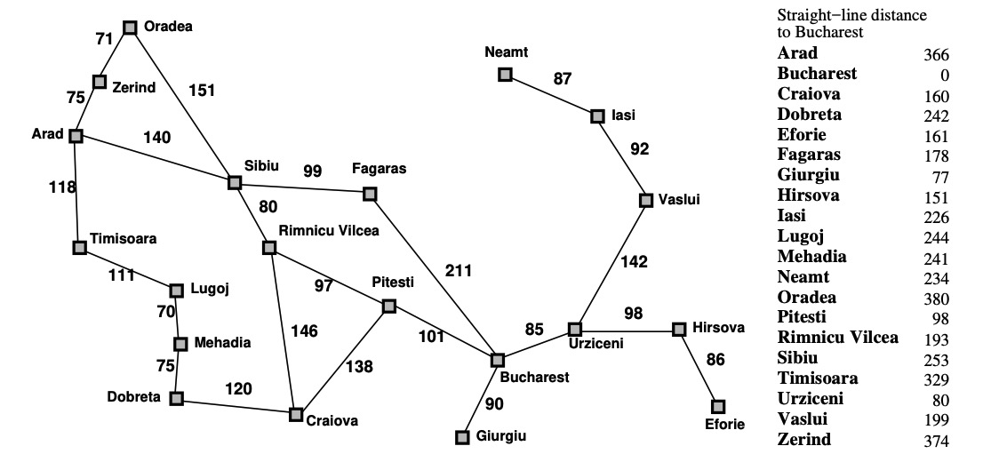
Exercise
This exercise uses the route-finding example with the Romanian map from Russell & Norvig
(Artificial Intelligence: A Modern Approach) as an example.
For the route from Arad to Bucharest, what order are nodes in the state space expanded for each of the following algorithms when searching for the shortest path between Arad and Bucharest? Where there is a choice of nodes take the first one by alphabetical ordering. For uniform0cost search include a check that nodes with the same state as previously expanded nodes are not added to the frontier. Stop the search when the goal state is expanded.
- A*

Slide 4
A
priority queue of frontiers
Node | g(n) | h(n) | f(n)
Arad [] | 0 | 366 | 366
Visited nodes:
[
Dr Armin Chitizadeh

Slide 5
A
Generated nodes are in yellow color
priority queue of frontiers
Node | g(n) | h(n) | f(n)
Arad [] | 0 | 366 | 366
Heuristic values
f(n) = g(n) + h(n)
Total cost from Arad to the current city
Visited nodes:
[
Dr Armin Chitizadeh

Slide 6
A
Z
S
T
priority queue of frontiers
Node | g(n) | h(n) | f(n)
Sibiu_{{Arad}} | 140 | 253 | 390
Timisoara_{{Arad}} | 118 | 329 | 447
Zerind_{{Arad}} | 75 | 374 | 449
Visited nodes:
[Arad{}
Dr Armin Chitizadeh

Slide 7
A
Z
S
T
Expanded nodes will turn blue
priority queue of frontiers
Node | g(n) | h(n) | f(n)
Sibiu_{{Arad}} | 140 | 253 | 390
Timisoara_{{Arad}} | 118 | 329 | 447
Zerind_{{Arad}} | 75 | 374 | 449
The priority queue of frontiers are sorted by f(n). After each round, the node with the lowest value of f(n) is taken out of queue
Visited nodes:
[Arad{}
Dr Armin Chitizadeh

Slide 8
A
Z
S
T
F
O
R
priority queue of frontiers
Node | g(n) | h(n) | f(n)
Rimnicu_{{A,S}} | 220 | 193 | 413
Fagaras_{{A,S}} | 239 | 178 | 417
Timisoara_{{Arad}} | 118 | 329 | 447
Zerind_{{Arad}} | 75 | 374 | 449
Oradea_{{A,S}} | 291 | 380 | 671
Visited nodes:
[Arad{} , Sibiu_{{Arad}},
Dr Armin Chitizadeh

Slide 9
A
Z
S
T
F
O
R
P
C
priority queue of frontiers
Node | g(n) | h(n) | f(n)
Pitesti_{{A,S,R}} | 317 | 98 | 415
Fagaras_{{A,S}} | 239 | 178 | 417
Timisoara_{{Arad}} | 118 | 329 | 447
Zerind_{{Arad}} | 75 | 374 | 449
Craiova_{{A,S,R}} | 366 | 160 | 526
Oradea_{{A,S}} | 291 | 380 | 671
Visited nodes:
[Arad{} , Sibiu_{{Arad}}, Rimnicu_{{Aarad, Sibiu}},
Dr Armin Chitizadeh

Slide 10
A
Z
S
T
F
O
R
P
C
priority queue of frontiers
Node | g(n) | h(n) | f(n)
Fagaras_{{A,S}} | 239 | 178 | 417
Bucharest_{{A,S,R,P}} | 418 | 0 | 418
Timisoara_{{Arad}} | 118 | 329 | 447
Zerind_{{Arad}} | 75 | 374 | 449
Craiova_{{A,S,R}} | 366 | 160 | 526
Craiova_{{A,S,R,P}} | 455 | 160 | 615
Oradea_{{A,S}} | 291 | 380 | 671
B
C
Visited nodes:
[Arad{} , Sibiu_{{Arad}}, Rimnicu_{{Arad, Sibiu}}, Pitesti_{{Arad,Sibiu,Rimnicu}},
Dr Armin Chitizadeh

Slide 11
A
Z
S
T
F
O
R
P
C
priority queue of frontiers
Node | g(n) | h(n) | f(n)
Fagaras_{{A,S}} | 239 | 178 | 417
Bucharest_{{A,S,R,P}} | 418 | 0 | 418
Timisoara_{{Arad}} | 118 | 329 | 447
Zerind_{{Arad}} | 75 | 374 | 449
Craiova_{{A,S,R}} | 366 | 160 | 526
Craiova_{{A,S,R,P}} | 455 | 160 | 615
Oradea_{{A,S}} | 291 | 380 | 671
B
C
Since we now have two nodes with a similar final city in our priority queue, we will then remove the one with a higher f(n) value.
Visited nodes:
[Arad{} , Sibiu_{{Arad}}, Rimnicu_{{Arad, Sibiu}}, Pitesti_{{Arad,Sibiu,Rimnicu}},
Dr Armin Chitizadeh

Slide 12
A
Z
S
T
F
O
R
P
C
priority queue of frontiers
Node | g(n) | h(n) | f(n)
Fagaras_{{A,S}} | 239 | 178 | 417
Bucharest_{{A,S,R,P}} | 418 | 0 | 418
Timisoara_{{Arad}} | 118 | 329 | 447
Zerind_{{Arad}} | 75 | 374 | 449
Craiova_{{A,S,R}} | 366 | 160 | 526
Oradea_{{A,S}} | 291 | 380 | 671
B
Visited nodes:
[Arad{} , Sibiu_{{Arad}}, Rimnicu_{{Arad, Sibiu}}, Pitesti_{{Arad,Sibiu,Rimnicu}},
Dr Armin Chitizadeh

Slide 13
A
Z
S
T
F
O
R
B
P
C
priority queue of frontiers
Node | g(n) | h(n) | f(n)
Bucharest_{{A,S,R,P}} | 418 | 0 | 418
Timisoara_{{Arad}} | 118 | 329 | 447
Zerind_{{Arad}} | 75 | 374 | 449
Bucharest_{{A,S,F}} | 450 | 0 | 450
Craiova_{{A,S,R}} | 366 | 160 | 526
Oradea_{{A,S}} | 291 | 380 | 671
B
Visited nodes:
[Arad{} , Sibiu_{{Arad}}, Rimnicu_{{Arad, Sibiu}}, Pitesti_{{Arad,Sibiu,Rimnicu}}, Fagaras_{{A,S}}
Dr Armin Chitizadeh

Slide 14
A
Z
S
T
F
O
R
B
P
C
priority queue of frontiers
Node | g(n) | h(n) | f(n)
Bucharest_{{A,S,R,P}} | 418 | 0 | 418
Timisoara_{{Arad}} | 118 | 329 | 447
Zerind_{{Arad}} | 75 | 374 | 449
Bucharest_{{A,S,F}} | 450 | 0 | 450
Craiova_{{A,S,R}} | 366 | 160 | 526
Oradea_{{A,S}} | 291 | 380 | 671
B
Since we now have two nodes with a similar final city in our priority queue, we will then remove the one with a higher f(n) value.
Visited nodes:
[Arad{} , Sibiu_{{Arad}}, Rimnicu_{{Arad, Sibiu}}, Pitesti_{{Arad,Sibiu,Rimnicu}}, Fagaras_{{A,S}}
Dr Armin Chitizadeh

Slide 15
A
Z
S
T
F
O
R
P
C
priority queue of frontiers
Node | g(n) | h(n) | f(n)
Bucharest_{{A,S,R,P}} | 418 | 0 | 418
Timisoara_{{Arad}} | 118 | 329 | 447
Zerind_{{Arad}} | 75 | 374 | 449
Craiova_{{A,S,R}} | 366 | 160 | 526
Oradea_{{A,S}} | 291 | 380 | 671
B
Visited nodes:
[Arad{} , Sibiu_{{Arad}}, Rimnicu_{{Arad, Sibiu}}, Pitesti_{{Arad,Sibiu,Rimnicu}}, Fagaras_{{A,S}}
Dr Armin Chitizadeh

Slide 16
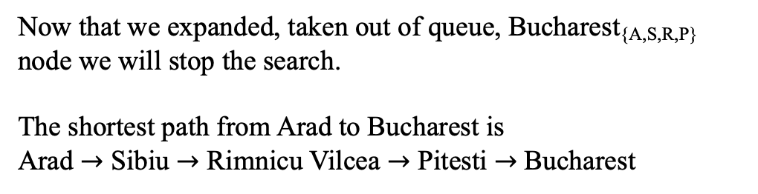
A
Z
S
T
F
O
R
P
C
priority queue of frontiers
Node | g(n) | h(n) | f(n)
Timisoara_{{Arad}} | 118 | 329 | 447
Zerind_{{Arad}} | 75 | 374 | 449
Craiova_{{A,S,R}} | 366 | 160 | 526
Oradea_{{A,S}} | 291 | 380 | 671
B
Bucharest_{{A,S,R,P}} | 418 | 0 | 418
Now that we expanded, taken out of queue, Bucharest_{{A,S,R,P}} node we will stop the search. The shortest path from Arad to Bucharest is Arad $→$ Sibiu $→$ Rimnicu Vilcea $→$ Pitesti $→$Bucharest
Visited nodes:
[Arad{} , Sibiu_{{Arad}}, Rimnicu_{{Arad, Sibiu}}, Pitesti_{{Arad,Sibiu,Rimnicu}}, Fagaras_{{A,S}}, Bucharest_{{A,S,R,P}}]
Dr Armin Chitizadeh

Slide 17

Feedback on this explanation:
https://forms.office.com/r/2GvFNxpJcA

Slide 18
Updates on version 1.1
Update | Page | Thanks to
The Bucharest_{{A,S,R,P}} value for g(n) and f(n) was calculated incorrectly but it was correct for later slides. The correct g(n) and f(n) value for Bucharest_{{A,S,R,P}} is 418 | Pages 12, 13 and 14 | Thanks to the student who filled the form and notified me of this typo

